Slide 1
Speeding Up Continuous Delivery with ElectricAcclerator
Jane Kuo
Group Product Manager
October 23, 2014

Slide 2






















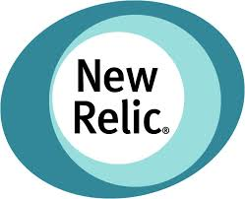
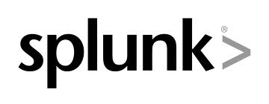















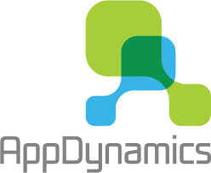
Electric Cloud: Powering Continuous Delivery
CONTINUOUS
ElectricAccelerator
ElectricFlow
DEV
OPS
Build & Test Acceleration
Pipeline Management and Visibility
Build
Build/Test
Deploy
ElectricCommander Automation Platform
DELIVERY
Plugs right in to
your existing tools
Notes:
So how do we do it?
ElectricCommander provides end to end pipeline automation and governance to help our customers build, test, and deploy at scale, making releases automated, predictable, and routine. It also provides easy integration our customers favorite tools if desired so that you can track everything.
And Electric Accelerator is patented technology (9 patents) that takes complex build and tests, discovers the dependencies inherent in the code, then parallelizes and safely distributes builds and tests across servers in a network and/or processor cores on a server. This results in build and test acceleration that can be orders of magnitude faster than what’s possible on a single server, while providing greatly improved infrastructure utilization.
We already have the world’s most powerful platform for build and test automation being used by customers like GE, SpaceX and GAP. In this release, we have extended Commander to be the best end-to-end continuous delivery platform. ElectricFlow, which is a suite of applications for continuous delivery spanning build, test and deploy dramatically accelerates time-to-value. With the deploy application, customers can easily model their applications, environments and deploy with a single click. The application is ready for mobile so that DevOps teams can trigger deployments and view progress on the go. Because these applications are built on our end-to-end continuous delivery platform, we bring together Dev and Ops with unparalleled visibility.
For an enterprise, continuous delivery is only continuous if you can rely on the platform 24/7 to be running builds, tests and deployments. This is the reality for our customers with globally distributed development sites. ElectricCommander can be set up in a high availability configuration so that if any server becomes unresponsive, other servers in the cluster pick up the work without skipping a beat. Customers can also add additional servers into their cluster to scale out to meet increasing needs.
Speed is essential for agile teams and continuous delivery. When build times take hours it is difficult for developers to get that fast feedback that they rely on to iterate on the product. ElectricAccelerator Huddle is our offering for small development teams to speed up their builds – it cuts down builds from hours to minutes to help them iterate faster.

Slide 3
Build-Test-Deploy Faster Deliver better software faster.
How long does it take to get a software update through your delivery pipeline?
Build
Compile, Package
Test
Functional, non-functional
Deploy
Provision, Configure, Deploy
weeks
manual handoff
manual handoff
+ automation
days
ElectricFlow
minutes
+ acceleration
ElectricAccelerator

Slide 4


Build/Test: The Tip of the Agile Spear
Increasing code size and complexity slows down builds/tests and makes dependency management complicated
Non-centralized build/test infrastructure allows local control but no economies of scale
Speed is essential for Agile teams and Continuous Delivery. When builds and tests take hours it is difficult for developers to get the fast feedback they rely on to iterate on the product.
Increased build/test frequency amplifies business impact of slow downs, reduces agility
Platform proliferation means more build targets and test environments

Slide 5
Acceleration without Compromise
20X faster builds and tests
74%
better infrastructure utilization
Accelerated software builds and tests with 100% correctness guaranteed
Leverages multi-core desktops or scalable cloud infrastructure
Patented dependency detection eliminates broken builds
Increases productivity and Agile throughput
Enterprise Scalability, Reliability, Visibility and Reporting
100% correct builds and tests
Notes:
EA does best in a CLUSTER, not core-for-core in big box
Big boxes is not a reality for everyone today

Slide 6

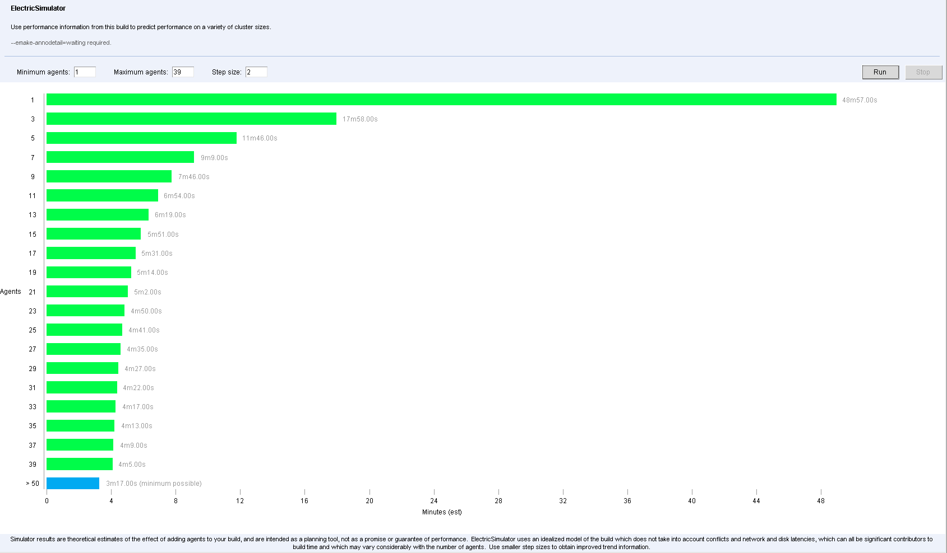
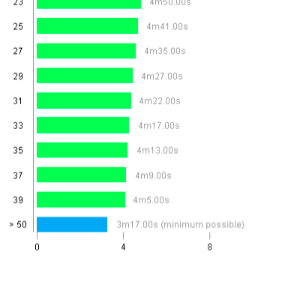
ElectricAccelerator Continuous Deliver Acceleration (Build + Test)
Massive parallelization and distribution for insanely fast builds and tests
Automatic dependency detection for faster, more accurate builds
Actionable visualization and reports for optimal builds
Efficient resource utilization. Create build clouds and lower costs
Notes:
Massively parallel, safe software builds Delivers up to 20x acceleration
Fast, accurate incremental builds Boosts engineering productivity
Non-intrusive and high performance Reduces manual maintenance significantly
Tool agnostic

Slide 7










ElectricAccelerator Value
95% faster cycle time
90% reduction in errors
75% improved resource utilization

Slide 8



Transformative Benefits
Challenges | Before | After
Speed | The fastest build server is still too slow | 10-20x speedup Agile enabler
Maintenance | Costly labor dedicated to build script maintenance and optimization | Completely automated dependency management Build optimization no longer needed
Scalability | Single servers bogged down Severe bottleneck for growth | Multi-server / multi-platform build environment 1000s of daily builds
Visibility | No understanding of internal build structure Very hard to optimize | Easy, intuitive build visualization enables rapid optimization
Control | No build audit trail Unmanageable burden on IT support | Centralized cluster provides full build history Fault-tolerant, central build farm, single admin interface

Slide 9
ElectricAccelerator Roadmap

Slide 10
Forward Looking Statements
This document contains forward looking statements regarding future operations, product development, product capabilities and availability dates. This information is subject to substantial uncertainties and is subject to change at any time without prior notification. Statements contained in this document concerning these matters only reflect Electric Cloud’s predictions and / or expectations as of the date of this document and actual results and future plans of Electric Cloud may differ significantly as a result of, among other things, changes in product strategy resulting from technological, internal corporate, market and other changes. This is not a commitment to deliver any material, code or functionality and should not be relied upon in making purchasing decisions.

Slide 11
ElectricAccelerator Product Strategy
1
Performance
Solve more problems
Accessible to more customers
2
3

Slide 12
Record of Innovation
1.0
Pilot-only
100% correctness
10-20x acceleration
3.x
Gmake parser update
Ledger
Visual studio integration via VSP v2.0
5.x
Electrify
7.x
Dependency Optimization
Parse avoidance
Javadoc caching
2002
2003
2005
2007
2010
2011
2013
2014
2.x
Linux support
Light-weight EFS
4.x
Version aware agent
LSF support
Visualization via ElectricInsight v2.0
6.x
Developer Edition
Chargeback report (on CM)
Multi-network interface
EA Huddle (Beta)
Freemium* for small teams
Gamified UI
New reports
Notes:
1.0 (2002 Nov): Pilot only. 10x-20x acceleration, e.g. 4:30 to 0:13
2.0 (2003 Oct): “Electric Cloud 2.0 accelerates builds 10 - 20 times by distributing the software build in parallel across clusters of inexpensive servers. It scales to accommodate additional servers for even more performance and throughput.” "Builds are an integral part of the software development process. In creating Electric Cloud 2.0 we wanted to ensure that our builds were not just fast, but 100 percent accurate," (http://web.archive.org/web/20031224023501/http://www.electric-cloud.com/news/20031015.html)
3.0 (2005 Nov)
4.0 (2007 Jun)
Sparkbuild (2009 Dec)
Einsight
Tech partnership
Klocwork:
Coverity: included with Coverity. Osoleted

Slide 13
What’s New
Performance
Schedule optimization
Dependency optimization
Parse avoidance
Javadoc caching
Linux readdir d_type support
EFS improvements for multi-threaded
Hybrid deployment model
Visual Studio Plugin 4.x
Toolchain virtualization
IDE integration modernization
Simpler configuration
Notes:
Linux readdir d_type → Up to ~10x
EFS improvements for multi-threaded → Up to~2x
VSP: Toolchain virtualization – don’t need to install V/S on ever agent -

Slide 14
ElectricAccelerator Roadmap
EA 7.2
EA 8.0
Backlog
Emake usability
Hybrid configuration
Performance optimization
Caching (Linux/Solaris, GCC)
New platform
RHEL 7
Windows 2012
Android L
Embedded Linux*
Junit test acceleration*
64-bit Cygwin
Virtualization assessment
Android L optimizations
Junit test acceleration feasibility
Embedded Linux (Bitbake) feasibility
Maintenance
7.2.1
Heartbleed
Maintenance
7.2.2
LOFS fixes
2014 q3
Future
2014H1
2014 q4
* Pending viability

Slide 15
Object Reuse
Faster FULL builds (like ccache) via cache and reuse of .o files
Target:
Output of GCC compiler
On Linux or Solaris platforms only
CI or Release builds launched by SINGLE user from SINGLE machine
Notes:
Cache .o: don’t compile if source didn’t change
Same machine: where the emake client

Slide 16
Object Reuse : Better than ccache
Our proprietary EFS helps us be
Faster
More accurate (for example, detect insertion of a new header into the include path).
Notes:
More accurate (RIM)
ccache consistent problems -

Slide 17
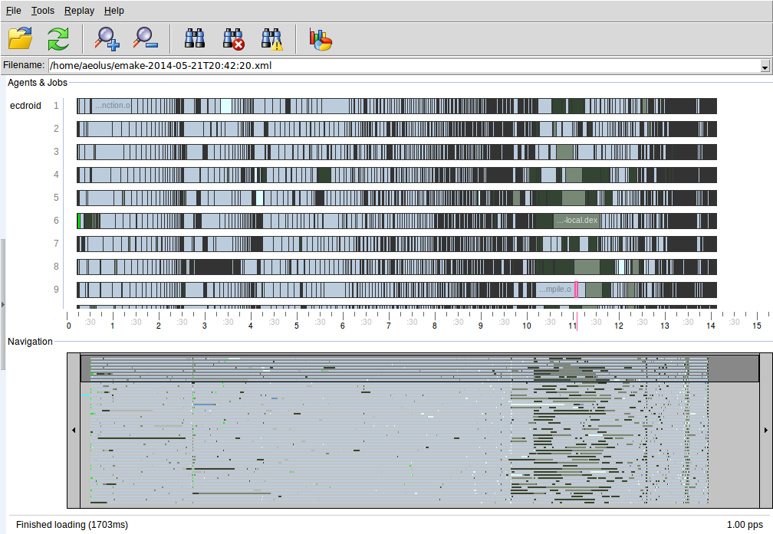
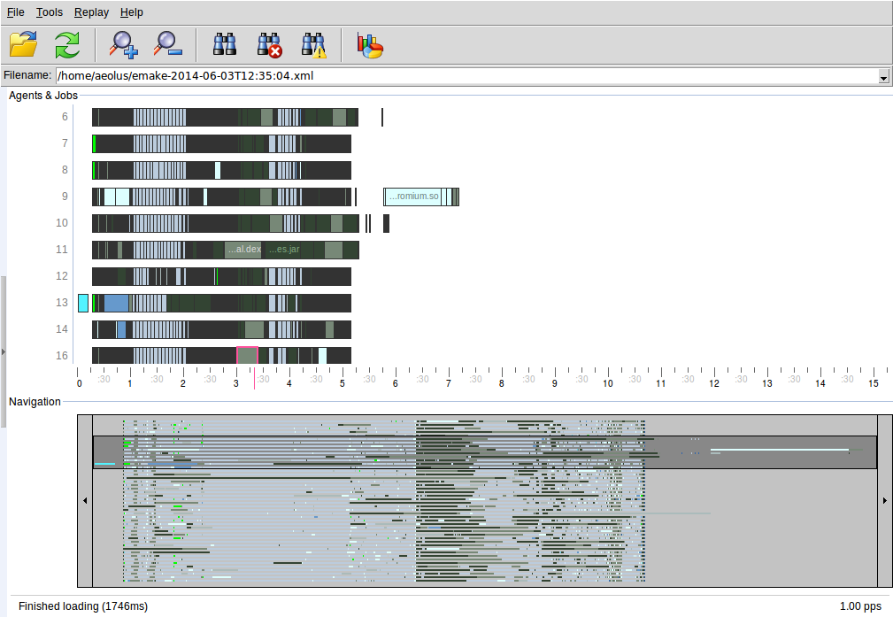
Object Reuse Benchmark: Android KitKat
Without Object Reuse: 15 min 20 sec *
With Object Reuse: 7 min 30 sec
* using EA 7.2 features (parse avoidance, dependency optimization, schedule optimization, & eDepend)

Slide 18
Object Reuse Benchmark: EA Internal Build
OS | Baseline (sec) | With Object Reuse (sec) | Speedup | Cache hit
Linux | 210 | 91 | 2.3x | 97%
Solaris | 1189 | 419 | 2.8x | 97%
Solaris x86 | 343 | 123 | 2.8x | 95%

Slide 19
ElectricAccelerator Roadmap
EA 7.2
EA 8.0
Backlog
Emake usability
Hybrid configuration
Performance optimization
Caching (Linux/Solaris, GCC)
New platform
RHEL 7
Windows 2012
Android L
Embedded Linux*
Junit test acceleration*
64-bit Cygwin
Virtualization assessment
Android L optimizations
Junit test acceleration feasibility
Embedded Linux (Bitbake) feasibility
Maintenance
7.2.1
Heartbleed
Maintenance
7.2.2
LOFS fixes
2014 q3
Future
2014H1
2014 q4
* Pending viability

Slide 20

Android Lollipop
Focus on accelerating Android AOSP.
Growing complexity
Expected to take up to 60% longer to build* than KitKat
Complex toolset
Open source project
Today – work with customers
[after GA] – work directly with
source code
* Based on an EA customer experience.

Slide 21
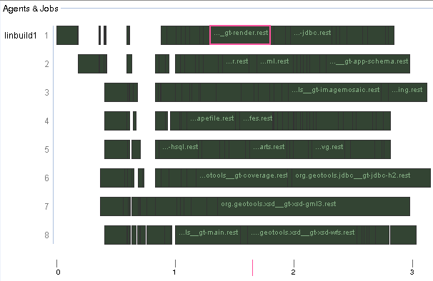
Junit Test Acceleration
Early-stage development with promising results
Fine-grained Junit test parallelization & distribution
Guaranteed Correctness
Minimized JVM overhead
Plug-and-Play integration into Maven & ANT-based builds
Notes:
Testing is often a bottleneck to the CD cycle ~60% (vs Compiling is ~20%)
From research with Osterman (2010) “the majority of software bugs are attributed to poor testing procedures or infrastructure limitations rather than design problems. Additionally, the software test process is generally considered an unpleasant process, with software development professionals rating the use of their companies’ test systems more painful than having a fender bender or preparing taxes.”
Drop in replacement for Junit TestRunner
Coarse grain: project-level
Fine-grain: class-level parallelization
Prelim results: 3-20x acceleration (ant)

Slide 22
Bitbake: Build tool for Embedded Linux
Bitbake is used to build a complete Linux system image
100s of packages: kernel, compilers, utilities, etc.
Used in automotive vertical via the Yocto Project
Smallest Yocto Project build is 4-5 hours serially!
Challenge accepted!
Notes:
* for on-board systems

Slide 23
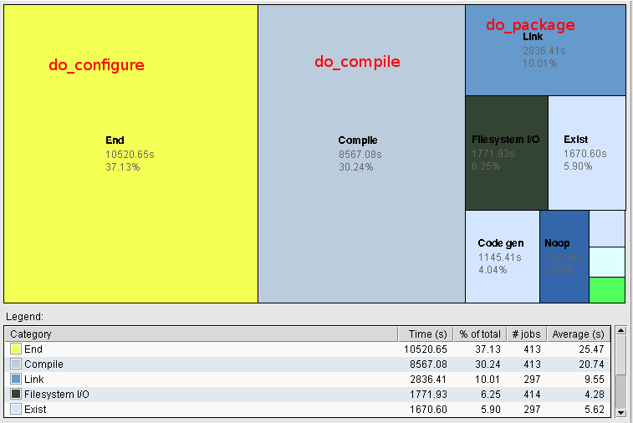
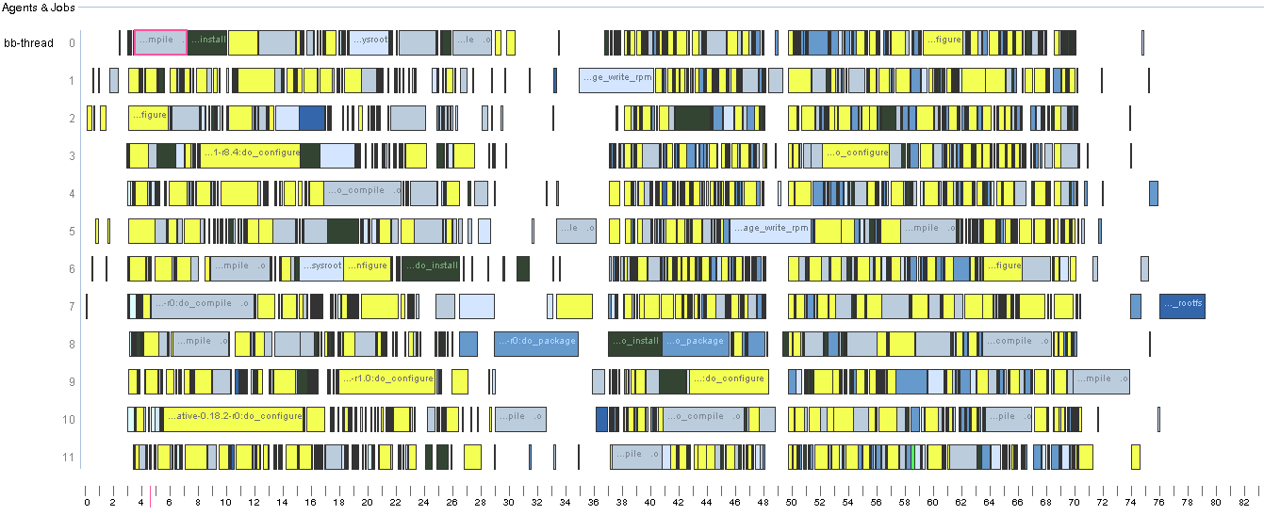
Bitbake: Acceleration Potentials Today
Bitbake buildstats data contains useful data…
Analyze build data in
Electric Insight*
Identify longest serial chain visually;
Understand relative time distribution by task
Configure bitbake to call emake instead of gmake
* The script to convert bitbake buildstats data into an ElectricInsight compatible annotation is available for download at the public
Electric Cloud GitHub Repository

Slide 24
Bitbake: Acceleration beyond “compile”
Leverage ElectricAccelerator across the entire process – add parallelization
among packages?
among different functions?
to existing functions?

Slide 25
ElectricAccelerator Roadmap
EA 7.2
EA 8.0
Backlog
Emake usability
Hybrid configuration
Performance optimization
Caching (Linux/Solaris, GCC)
New platform
RHEL 7
Windows 2012
Android L
Embedded Linux*
Junit test acceleration*
64-bit Cygwin
Virtualization assessment
Android L optimizations
Junit test acceleration feasibility
Embedded Linux (Bitbake) feasibility
Maintenance
7.2.1
Heartbleed
Maintenance
7.2.2
LOFS fixes
2014 q3
Future
2014H1
2014 q4
* Pending viability

Slide 26
ElectricAccelerator Product Strategy
Acceleration without compromise
1
Performance
Solve more problems
Accessible to more customers
2
3

Slide 27

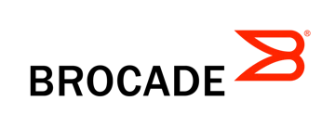

Transformative Benefits
Minutes FASTER TROUBLESHOOTING 20 days
90% improvement
TIME
45 minutes FASTER BUILDS 3 hours
76K developer hours saved/year
ERRORS
400 BETTER INFRASTRUCTURE UTILIZATION 1000’s
Massive savings on capital, power, cooling
SERVERS

Slide 28



















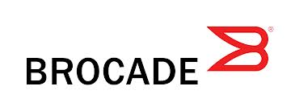




















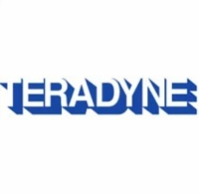







Thank you
Q&A
@ DOES 2014: Visit “Dr. Is In” in Exhibit Hall
Anytime : jane@electric-cloud.com
Networking
Mobile Devices
Semiconductor
ISV, Internet & Entertainment
Financial
Services
Automotive
Medical Devices
Aerospace / Defense
Heavy Industry
Other Systems
Notes:
Here’s a sampling of our customers
MS has deployed a B-T cloud on our solution
Vmware uses us for test mgmt in the Vcloud director group
RIM has built a cloud to manage the B-T process for all their phone software

Slide 29
Backup

Slide 30
FAQ

Slide 31
What is ElectricAccelerator Huddle?
Huddle is Electric Cloud’s freemium build/test acceleration product
Huddle is built for small teams and won’t scale the way EAE does
Huddle only allows one build to occur at any given time — e.g., “first in wins — and 100% of resources go to that build until it’s complete.”
EAE provides the enterprise with scalable, centralized acceleration
EAE offers centralized management – e.g. update
Huddle doesn’t have the dedicated hardware that most large companies will want for their acceleration pool

Slide 32


ElectricAccelerator Enterprise versus Huddle
Features | EAE | EAH
Adaptive schedule optimization
Accurate dependency management
Fault tolerance
Electric File System – a high-performance versioned file system
Visual Studio integration
Policy-driven resource allocation/optimization
Cluster sharing - enable multiple distributed builds concurrently
Centralized management
Scalability
Dedicated hardware
Enterprise-readiness
Licensing model | Subscription/ Perpetual | Pay-per-use
Disconnected builds | Unlimited* | 8 cores
Support | 24/7 | community
ElectricInsight | Optional add-on | Optional add-on
Notes:
32

